Slide 1
END-TO-END LEARNING FOR SELF DRIVING CARS
Vaidehi Som
Indian Institute of Technology Jammu
Dept of Mechanical
Internship report
Under the guidance of
DR. VIRENDRA SINGH,
Professor, IIT Bombay, Dept. of CSE

Slide 2
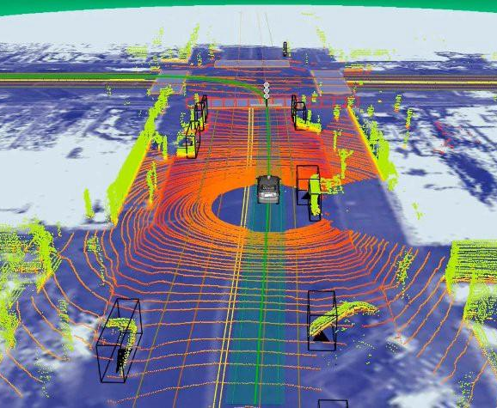
INTRODUCTION
Autonomous Cars Self driven cars that can perceive and drive without human intervention.
Sense
Process (model the outside world and take decisions)
React, with appropriate movement.
Object avoidance & Path following Detect objects and follow path from sensor data.
Deep End-to-End Learning:
Machine learning method based on learning data representations.
E2E learning - Direct Input to Output mapping without data-process decomposition.
Deep learning – Neural nets with multiple layers of hidden representations.

Slide 3
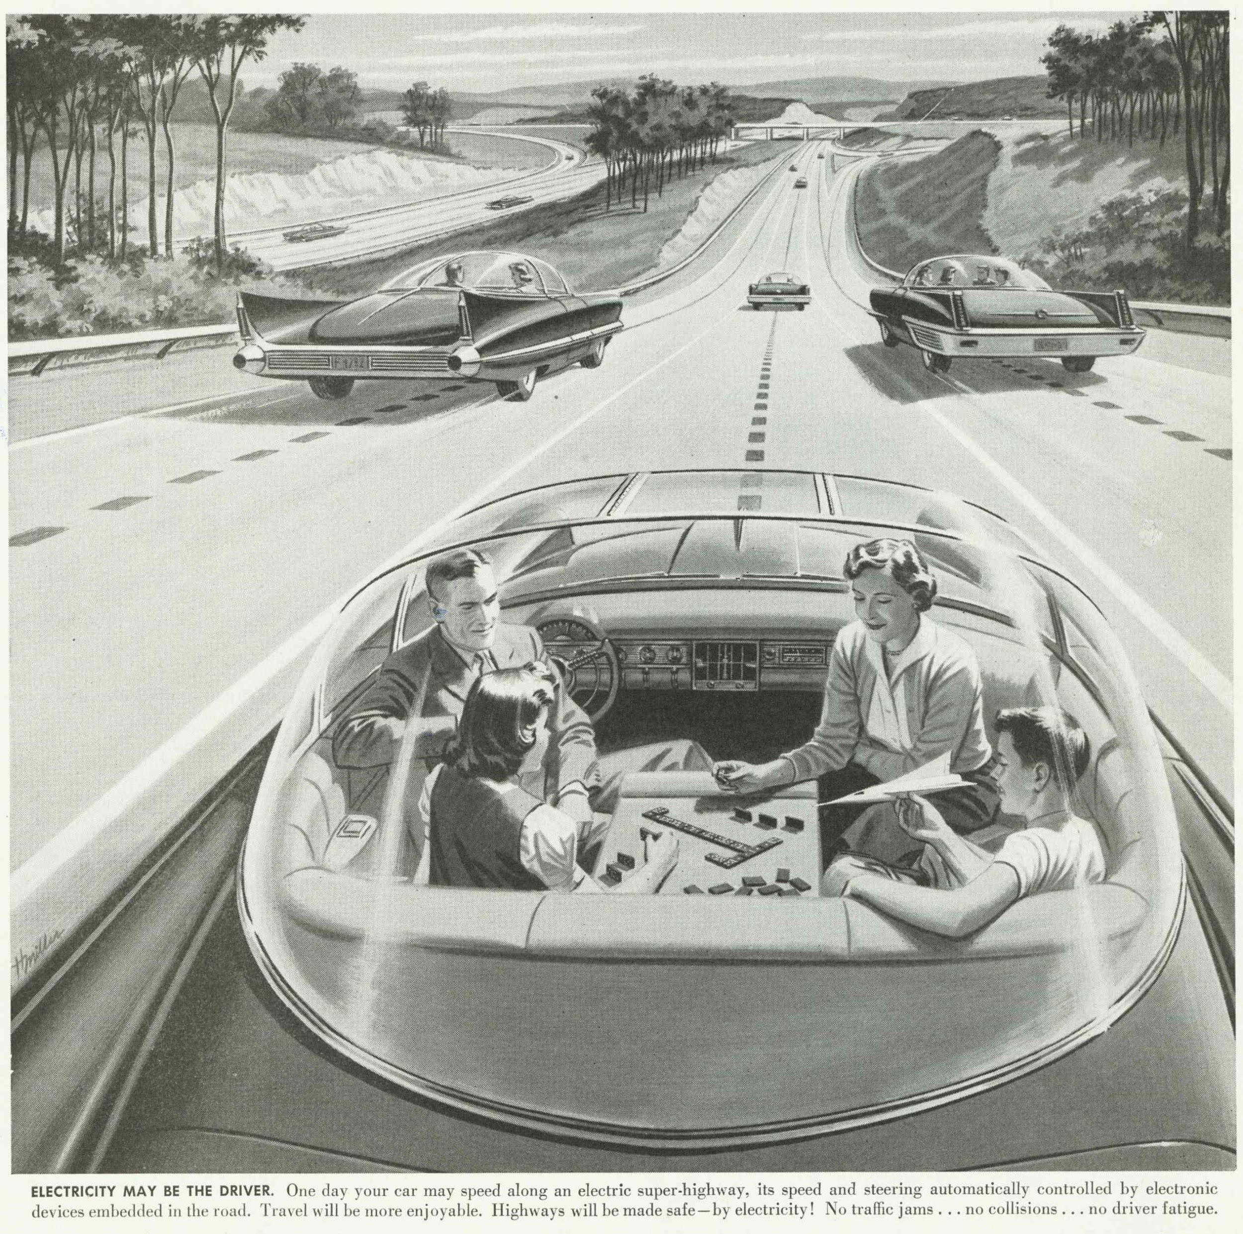
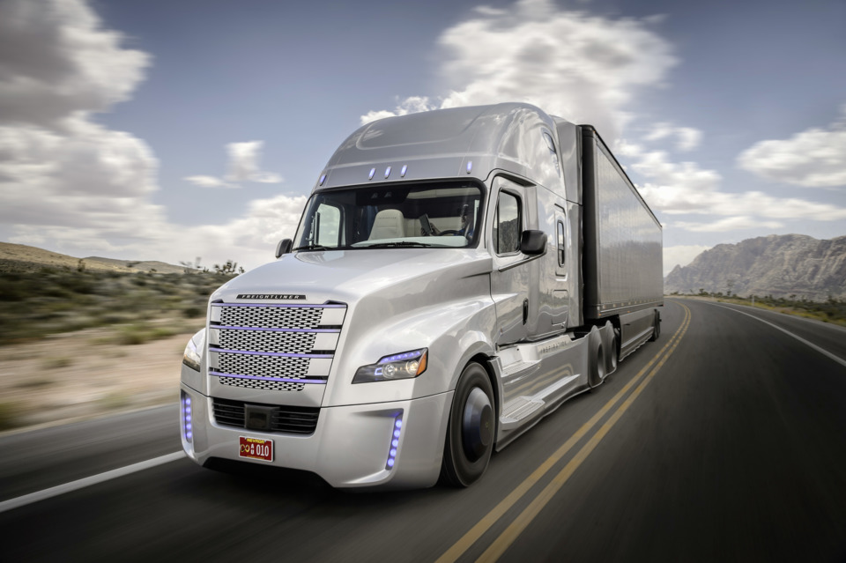
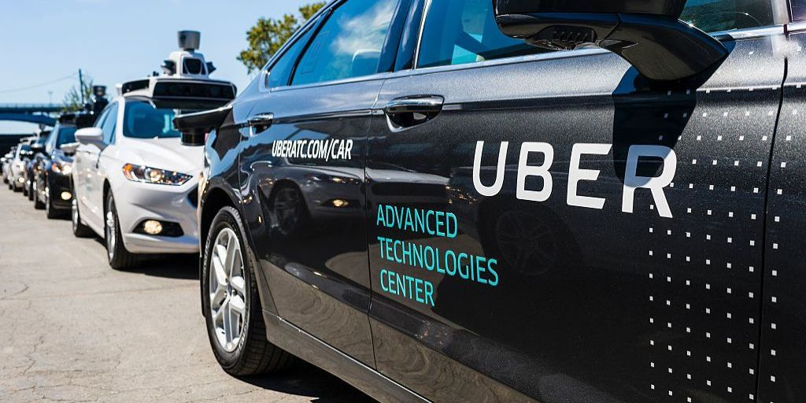
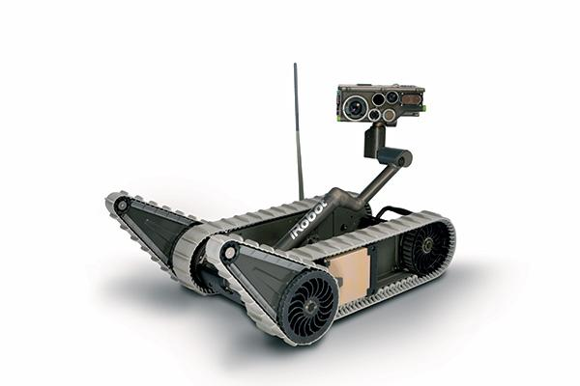
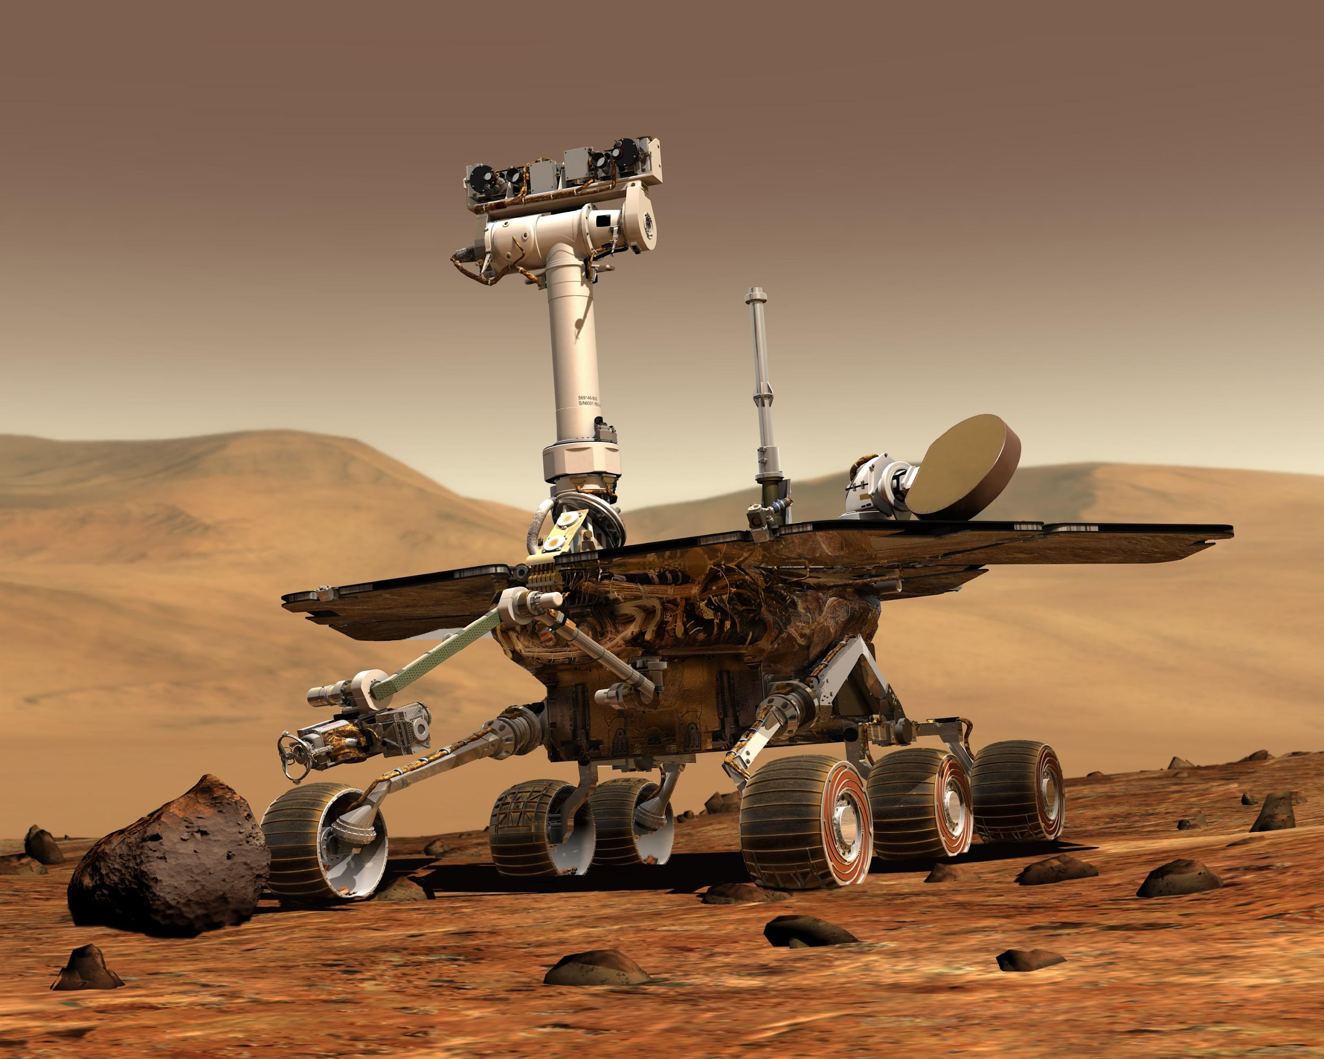
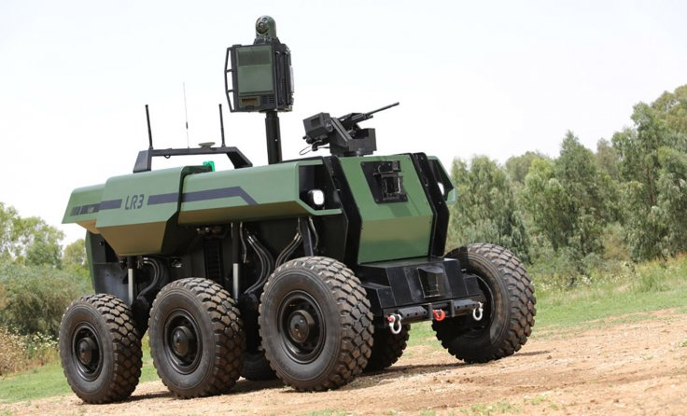
MOTIVATION
An artist’s impression of an autonomous car, 1936
Heavy vehicle can operate for long distance without driver fatigue.
Shared communication on urban/city streets
Surveillance and Maintenance bot
Autonomous planetary expedition rover
Military Surveillance Vehicle

Slide 4
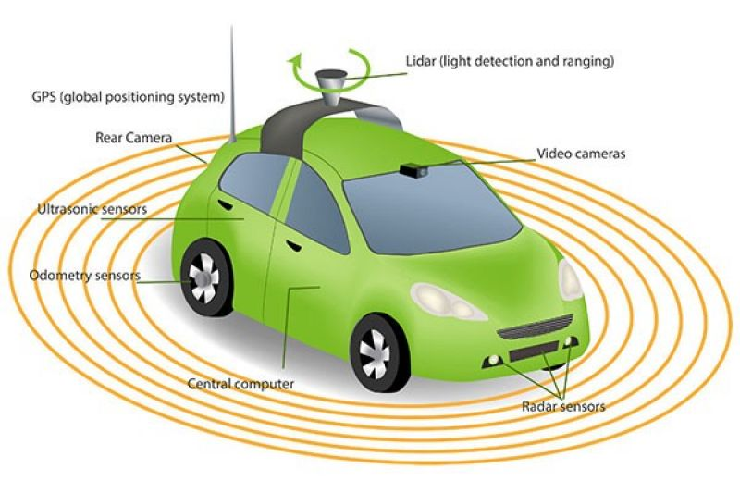
OBJECTIVE
Objective : Exercise and implement Deep learning methodology for autonomous control of the car.
Study of various deep learning approaches for autonomous vehicle.
To develop deep learning based model which performs object detection and avoidance in autonomous vehicle.
Testing and validation of the proposed model.
Various sensors equipped to a car.

Slide 5
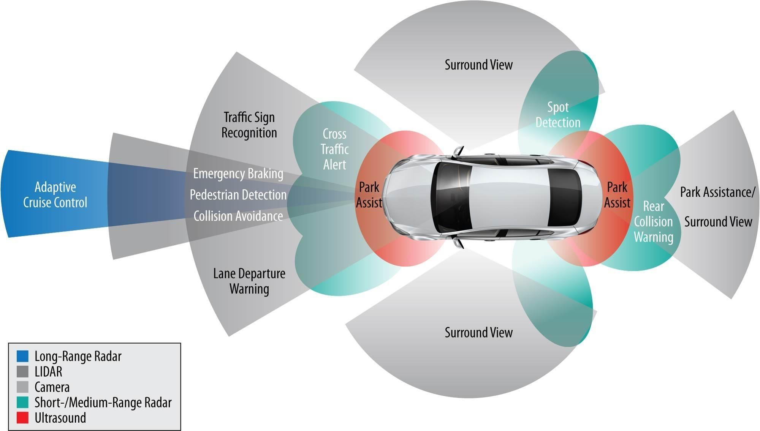
LITERATURE REVIEW
ADAS
Vehicle detection,
Lane detection
Object detection
Traffic sign indicator
Parking assistance
Adaptive Cruise control
Surround view

Slide 6
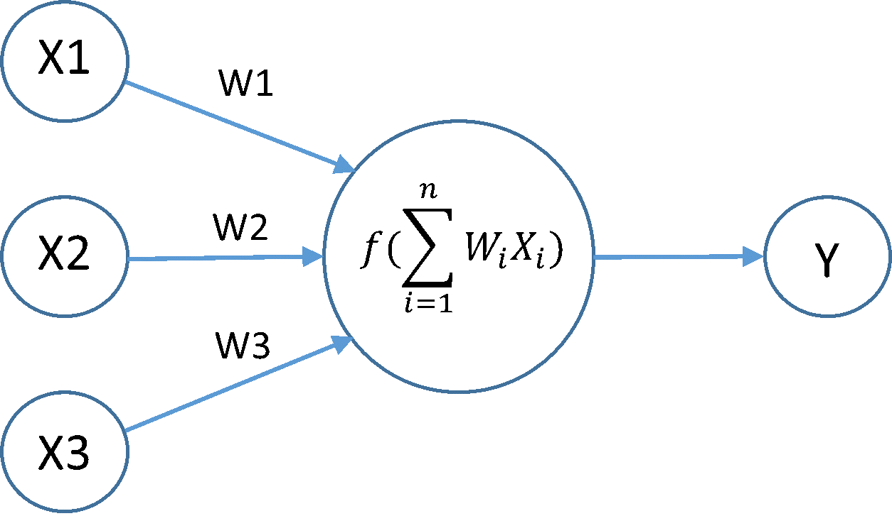
LITERATURE REVIEW
Neural Networks :
Distributed parallel processing unit made up of perceptrons.
Ability to learn from experience.
Works for a wide range of problems.
Perceptron with weights and activation function.

Slide 7
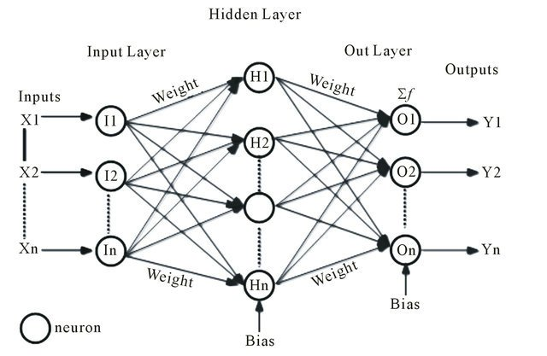
LITERATURE REVIEW
Backpropagation
Effectiveness:
Works for any number of hidden layer
Deeper the network -> complexity increases
Using different update rule:
Adagrad
RMSprop
SGD
Adam
Tuning Hyperparameter:
Weight values
Learning rate
Bias

Slide 8
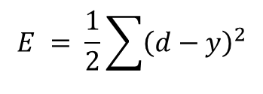
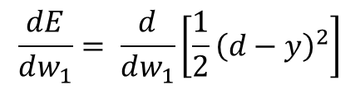
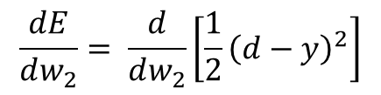
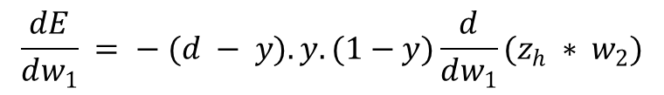
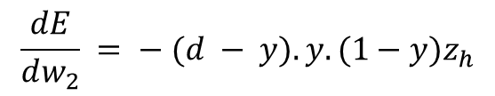
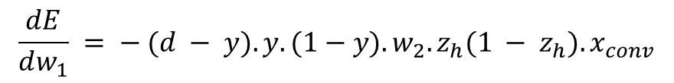
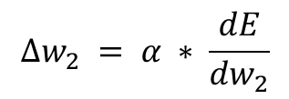
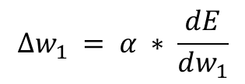
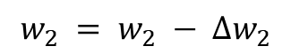
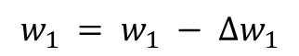
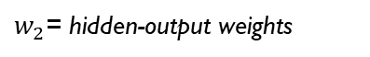
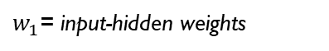
LITERATURE REVIEW
Backpropagation
Parameter update: Stochastic gradient descent
Updated weights to be used in next iteration.

Slide 9
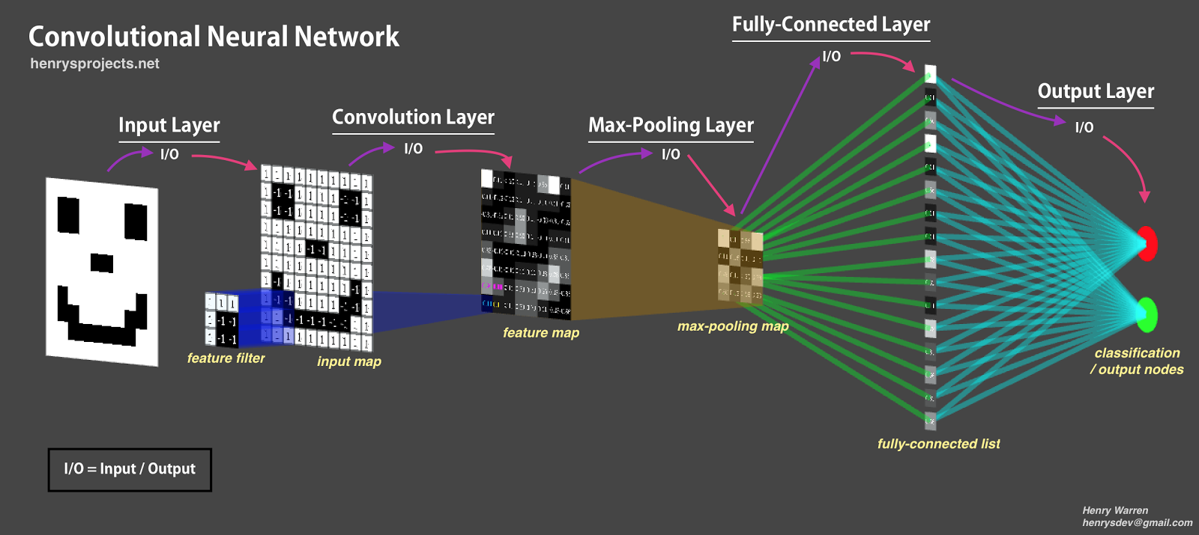
LITERATURE REVIEW
Convolution Neural Networks
Kernels, instead of weights to extract features.
Every kernel creates a different representation of feature maps.
Pooling is done to reduce redundant data.
3 basic layers : convolution, pooling, flatten, fully connected layer.
Simple CNN architecture

Slide 10

LITERATURE REVIEW
Convolution Neural network
Convolution:
Input array size = 90
Kernel array size = 5
Number of Filters = varies layer to layer
Number of layers = Also varies based on problem. (hyperparameters)
Pooling:
Max pooling, Average pooling,
Reduces the size of the input, bringing out crisp features.
Activation function:
Bounds the output values between range.
Provides gradient to the inputs.
Types -> sigmoid, tanh, SoftMax, ReLU
Fully Connected Layer:
Reshapes the convolution tensors
Decision making layer
Forms the output layer with activation function.

Slide 11
LITERATURE REVIEW
Neural Networks | Convolution neural Networks
Can perform both Supervised and Unsupervised Learning | Can perform both Supervised and Unsupervised Learning
Inputs are shuffled along the layers | Inputs adjacency is preserved along the layers.
Less computational complexity | Computationally more complex
Large networks are time consuming | Comparatively more time consuming

Slide 12
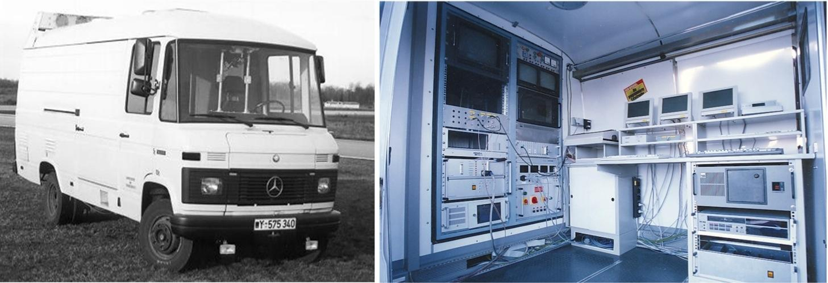
LITERATURE REVIEW
⁴Deep Learning for Automated Driving:
Addresses 2 detection problem: Vehicle and Lane
Uses MATLAB’s deep learning and GPU acceleration modules.
Uses a convolution neural network for learning both tasks.
¹ALVINN: An Autonomous Land Vehicle in a Neural Network:
3 layer backpropagation neural network for road following.
Uses camera and laser range finder as inputs
Trained using simulated road images.

Slide 13
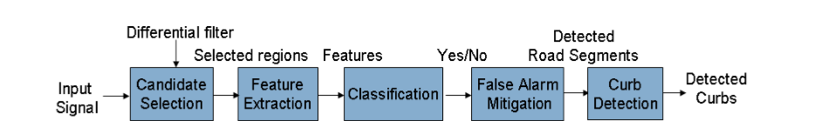
LITERATURE REVIEW
¹³LiDAR- based road and road-edge detection:
Uses only LiDAR range data as input.
Pre-processing of LiDAR data to form elevation maps and line representation of ground plane.
Trains the classifier using SVM.

Slide 14
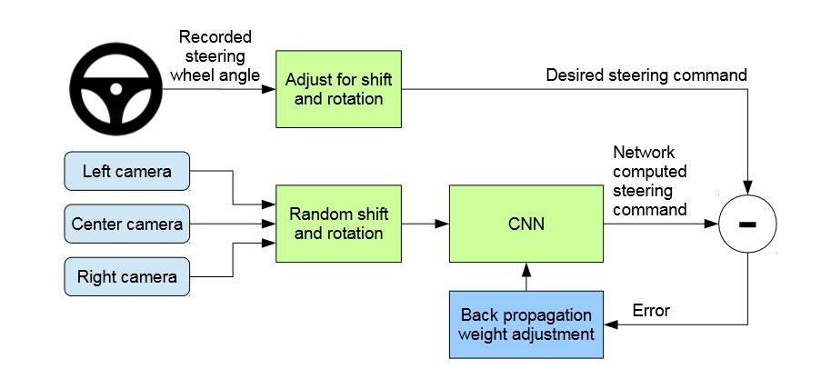
LITERATURE REVIEW
⁸End to End learning for Self-Driving cars:
Uses 3 mounted cameras.
Inputs raw image data from 3 cameras and outputs steering angle.
Trained by a human driver, who provides steering angles as training signals.
CNN for classification
Backpropagation for Weight adjustment
Schematic of DAVE 2

Slide 15
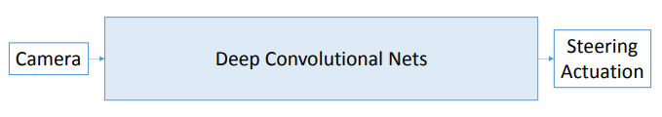
LITERATURE REVIEW
End to End learning:
Variant of deep learning for complete input to output mapping.
Learns complex representation of the system, without decomposing them into independent modules.
Uses gradient descent methods to guide a random initial state to a highly non-trivial solution.
Amount of training data increases exponentially with the number of modules used.
Every learning step is directed to the final output, by the overall objective function.
Optimization is based on variants of Stochastic Gradient Descent methods.
“Dave” - DARPA’s seedling project, - Yann LeCun and Urs Muller, uses this model for end-to-end learning

Slide 16
PROPOSED WORK
Progress of Project
Implementation of End-to-End learning
Neural Net
Convolution Neural networks
Training the network (Data?)
Designing a 1D-distance acquisition sensor
Designing a robot for driving data.
Training the network on data
Direction classification using Distance acquisition sensor data for object avoidance
Actuator data prediction using Images for path following

Slide 17
PROPOSED WORK
Neural networks And Convolutional neural networks:
Both are state-of-the-art self learning mathematical model
Can be used for both classification and regression tasks
Consists of hidden layers, containing large number of neurons
Both models can perform on gradient based optimizers
Hyperparameters are : number of layers (pooling and fully-connected), number of neurons in each layer, optimizer, loss function, activation function, kernel size and strides ( for convolutionalNN).
Also known as deep learning algorithms

Slide 18
PROPOSED WORK
End-to-End learning:
Traditional Approach
Developing image and different sensor feature extractors.
Hand labelling a large set of object on the road.
Decisions made of hand-crafted rules
Sensors
Deep Convolutional Neural Network
End-to-End Approach
Learns to steer by observing a human driving pattern
No hand-crafted rules.
No labelling of objects
Actuation

Slide 19
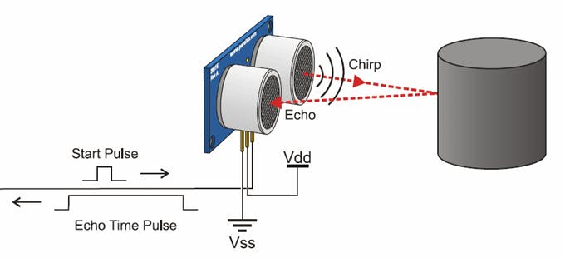
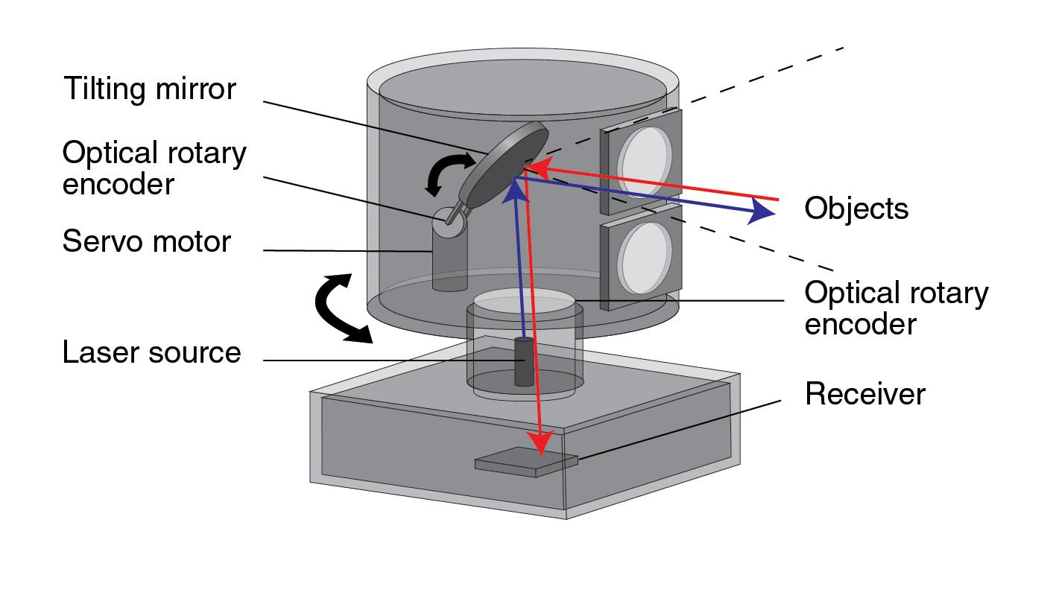
PROPOSED WORK
Component Overview:
Ultrasonic Sensor:
Uses sound wave to measure distance.
Min – Max range -> 0.02m – 4m
Affected by temperature and humidity of the air.
LiDAR:
Light imaging Detection And Ranging
Min – Max range -> 0.5m – 20m
Low response time
Can detect almost any object.
Uses pulsed laser light to measure distance.
Working of an ultrasonic sensor
Working of a LiDAR

Slide 20
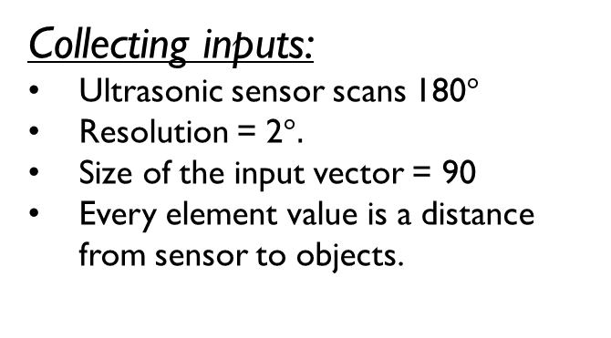
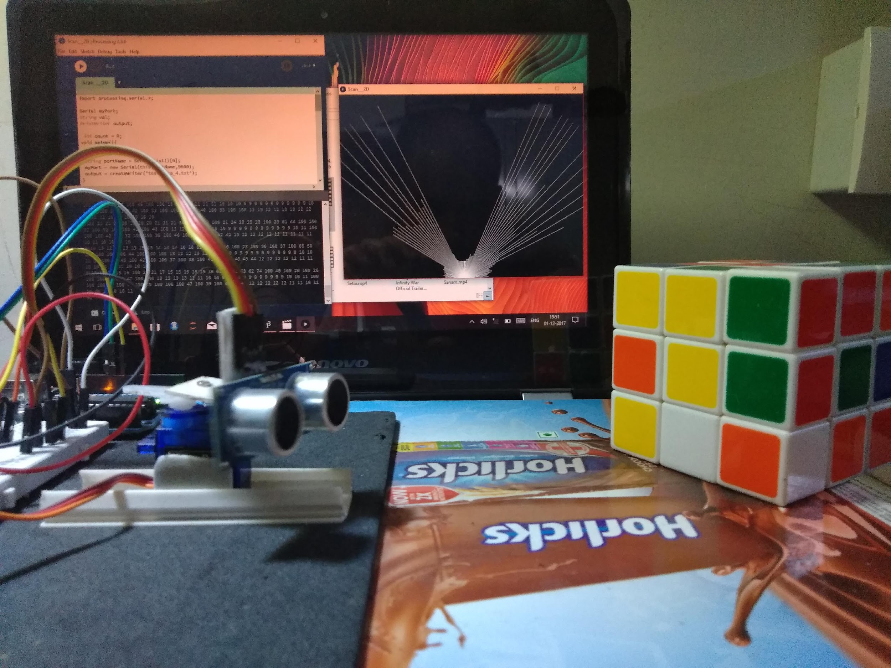
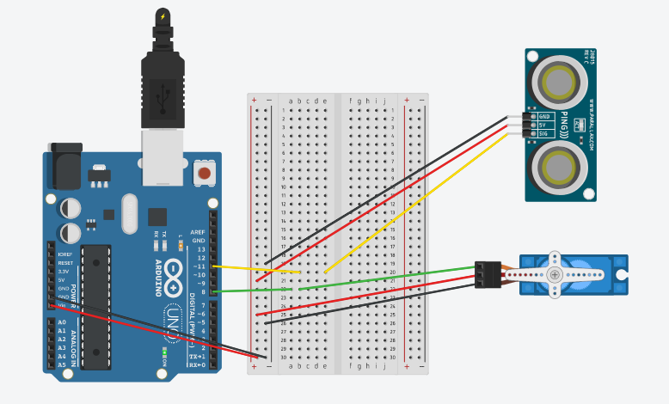
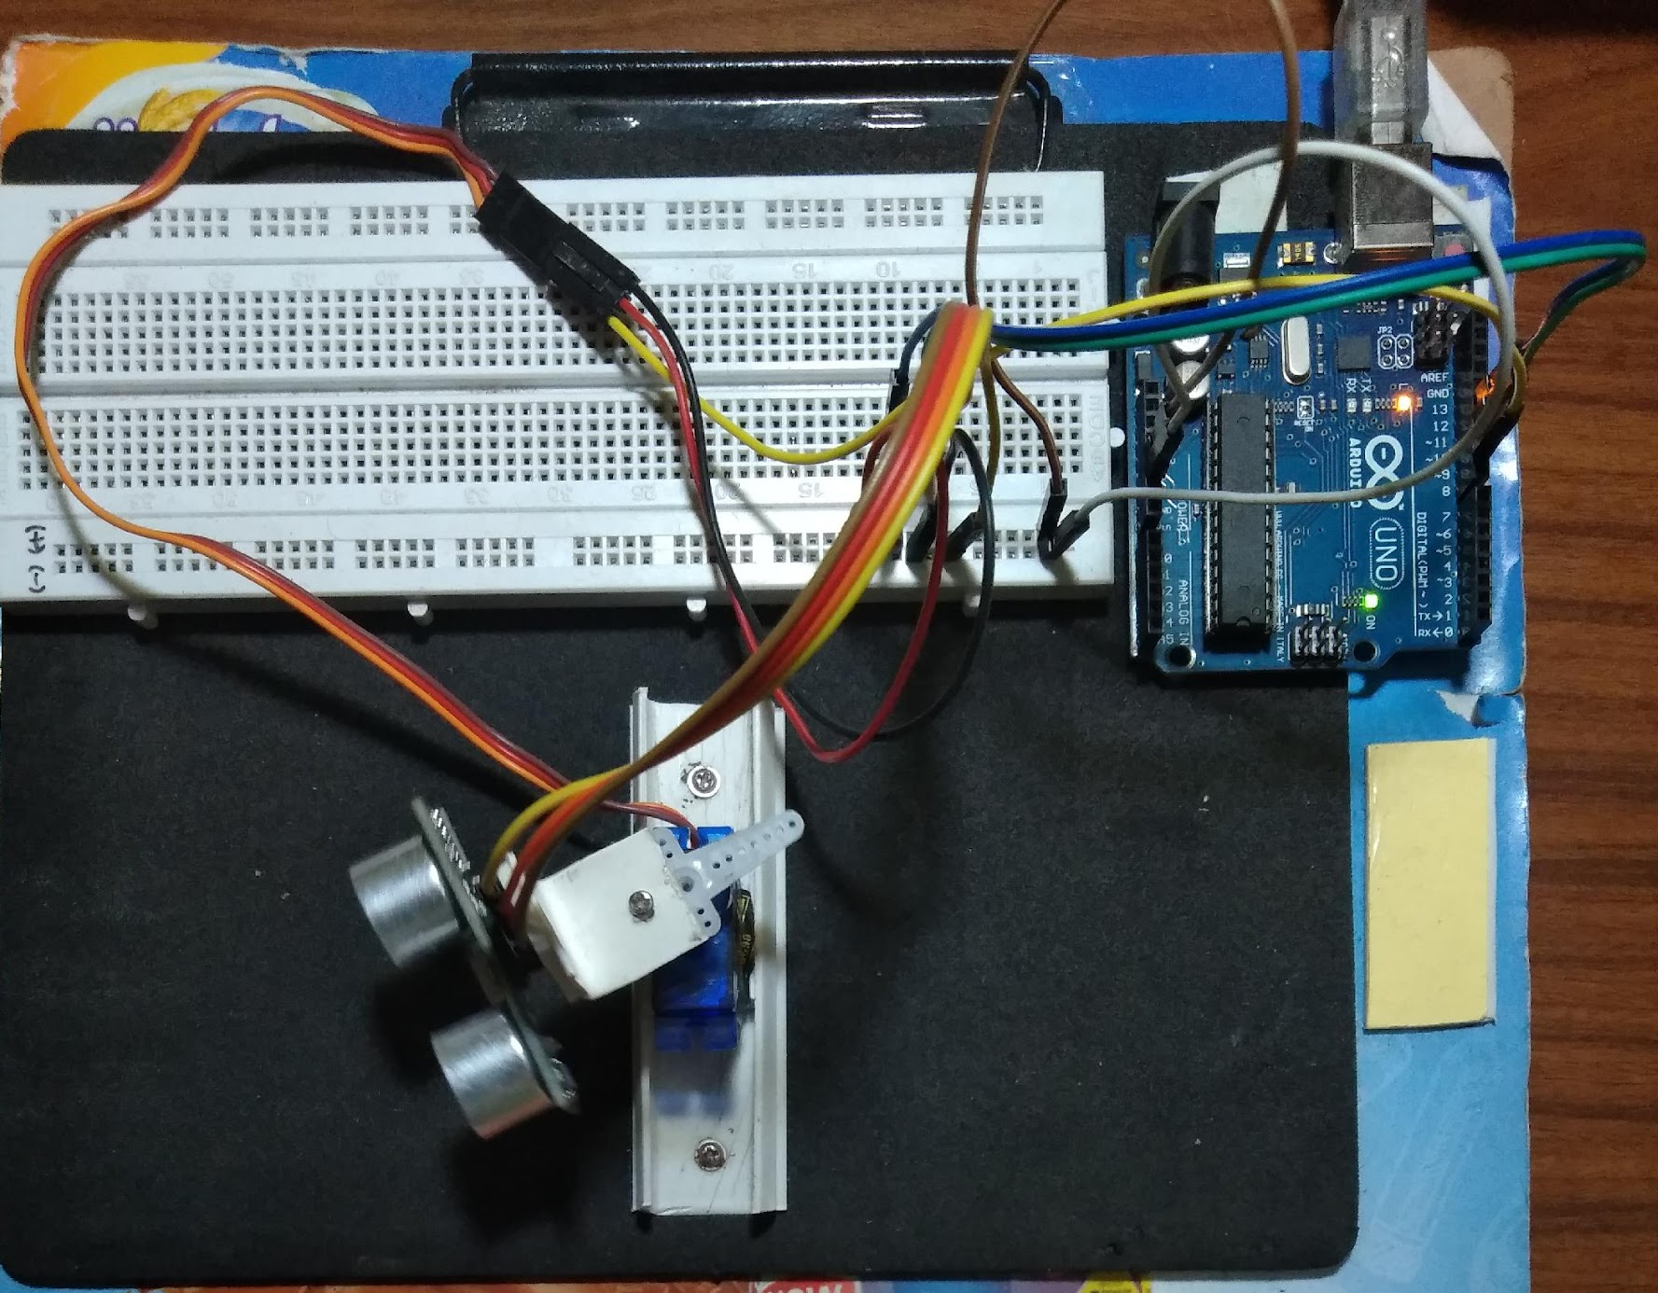
PROPOSED WORK
Scan of the surrounding, with visualization
Output Label:
Straight -> [1 0 0 0]
Left -> [0 1 0 0]
Right -> [0 0 1 0]
Back -> [0 0 0 1]
Setup of the prototype

Slide 21
PROPOSED WORK
Component Overview:
Microcontroller | Joystick | Bluetooth | Motor Shield | Camera | Chassis & Motor | Remote System
Arduino UNO R3 | RedGear | HC-05 | L298N | Android Phone | Assembled | Laptop
Operating Volt = 5V Recommended = 7 – 12V Atmega 328 microprocessor | 2 axis controller | OV – 3.3 V– 5V PIO control 9600 baud rate Connects with last device on power up | Input = 12V Output = 5V 16 pin IC | Resolution – 240 x 320 Frame rate = 10 fps Accessible through IPWebcam App Integrated Wi-fi. | Dim = 32x27 cm 2 motor wheel , one supporting wheel Stages microcontroller, camera, bluetooth, motor shield. | Wi – fi connectivity. Data storage Control signal transmission unit. Processing unit
Control of all components | Controlling the bot | Control receiving unit. | Controls 2 set of DC-Motors | Capture Images | Robot platform | Robot control unit.

Slide 22









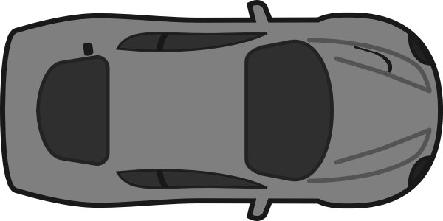
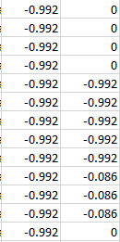


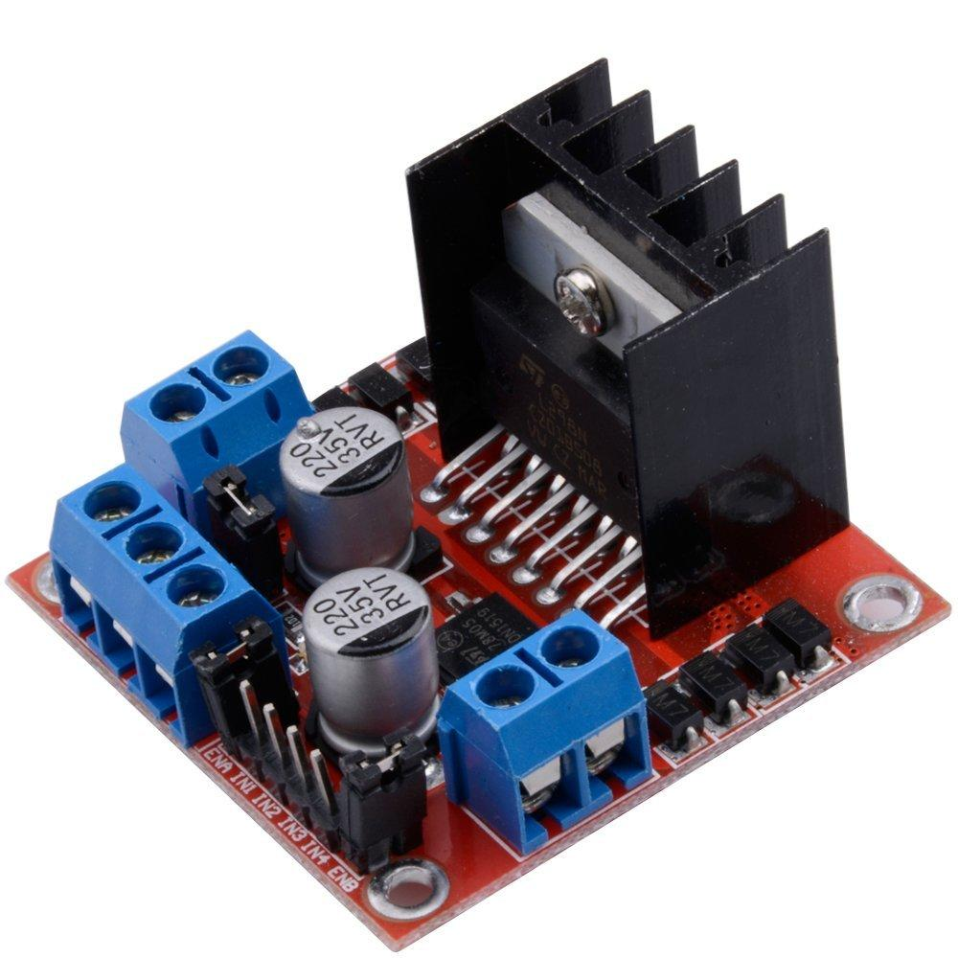
PROPOSED WORK
Component Assembly
Record saved data .csv
5V
Gnd
W_set1
W_set2
5V
Gnd

Slide 23
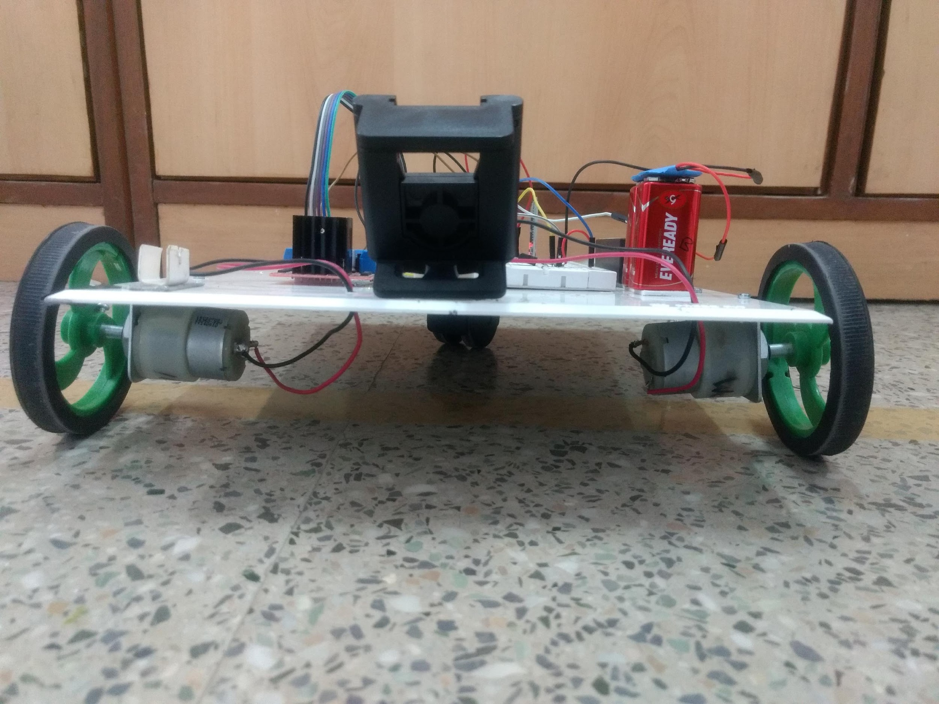
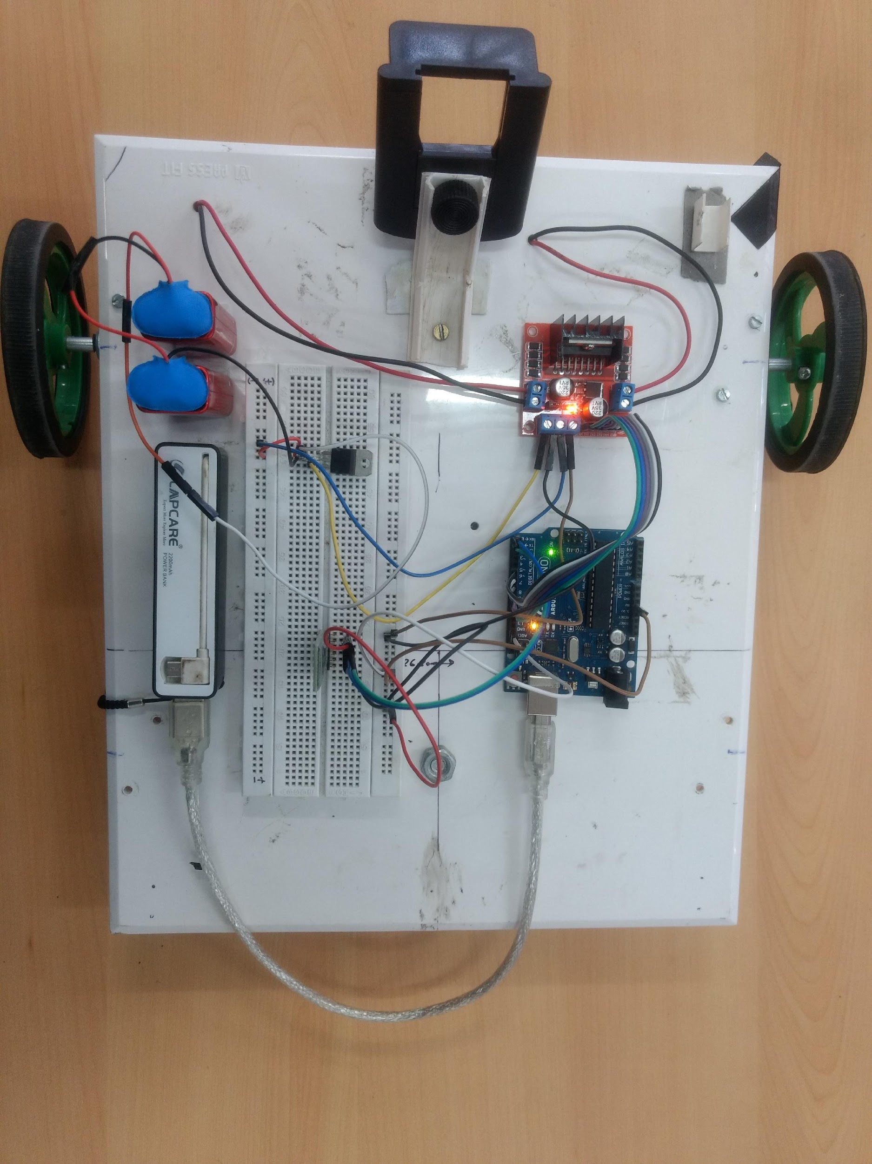
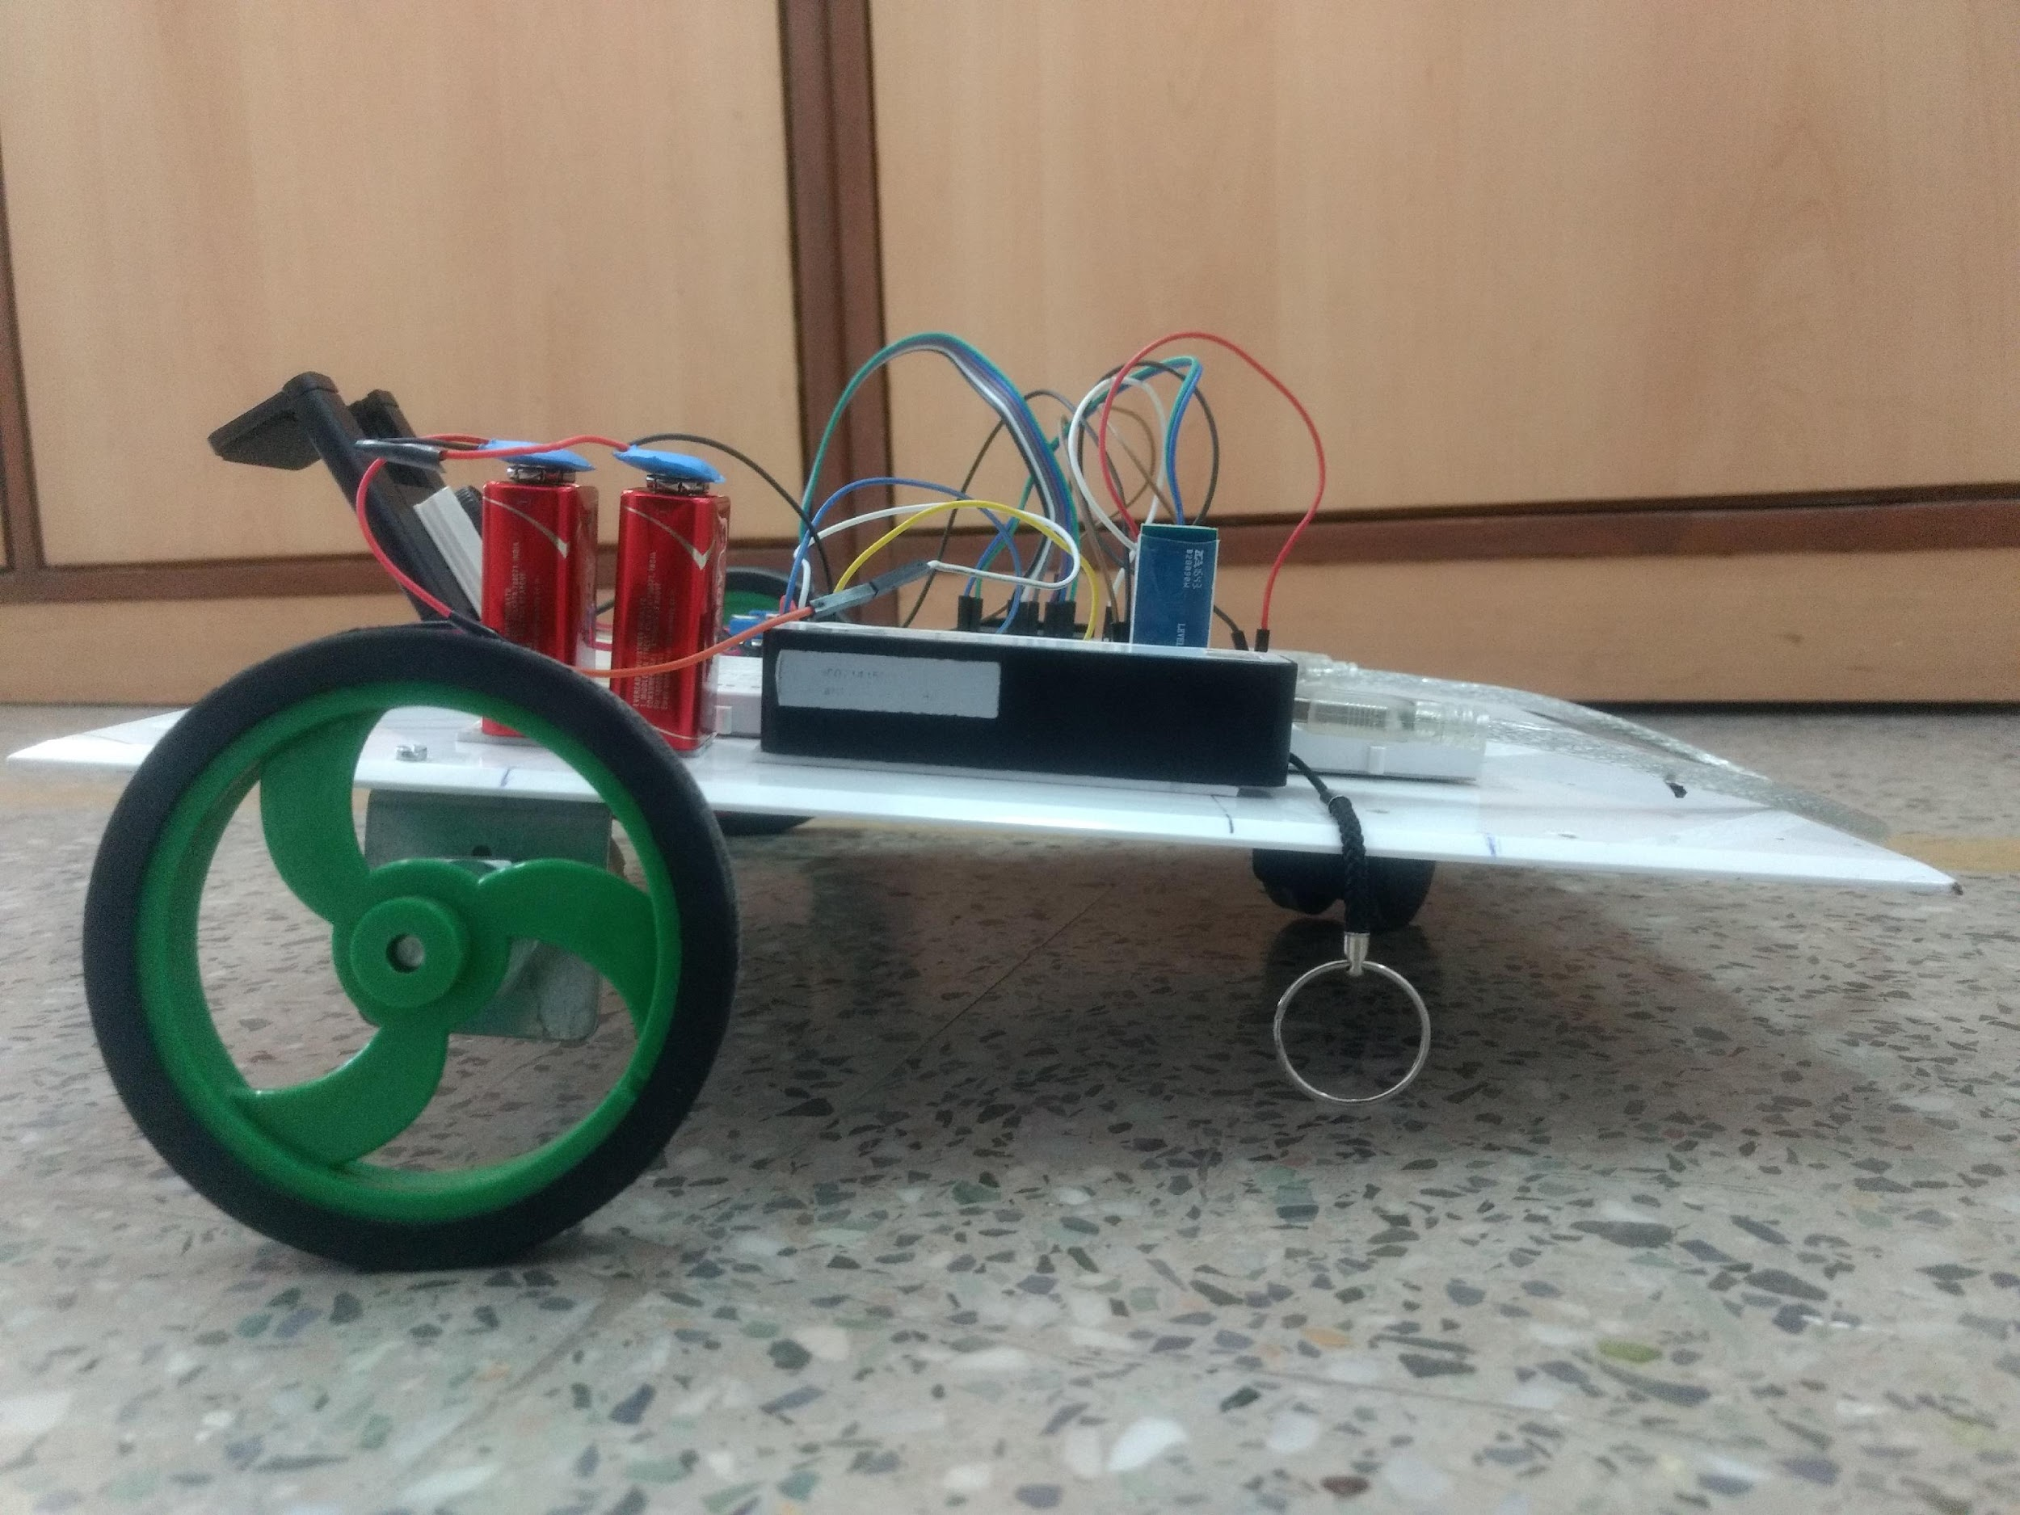
PROPOSED WORK
Data acquisition robot for end-to-end learning
Front View
Side View
Top view

Slide 24
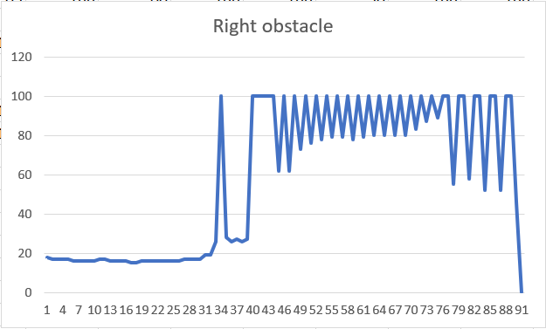
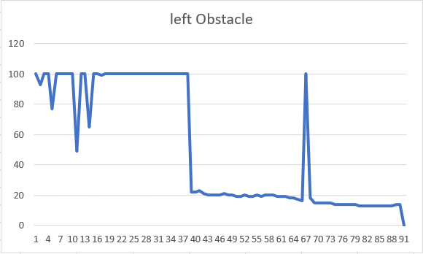
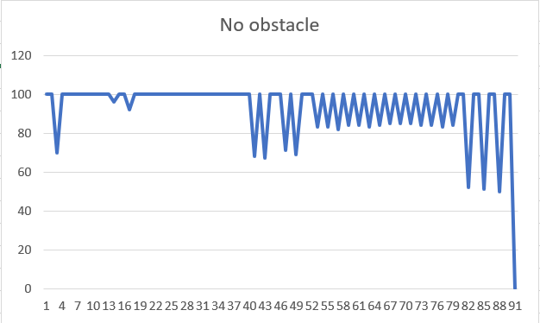
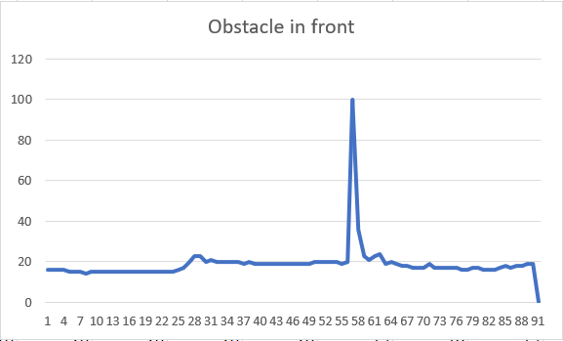
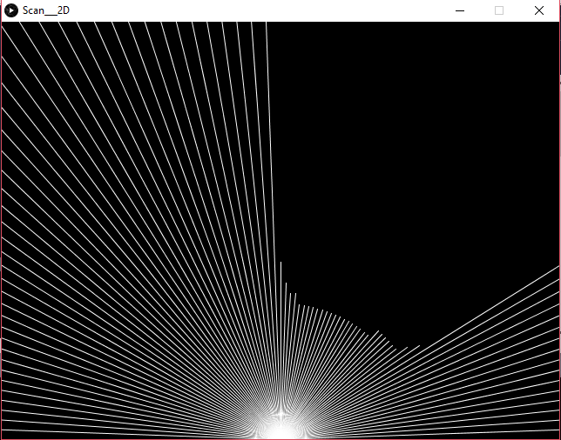
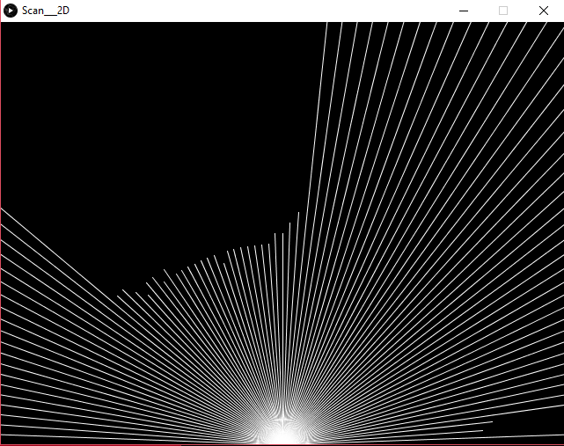
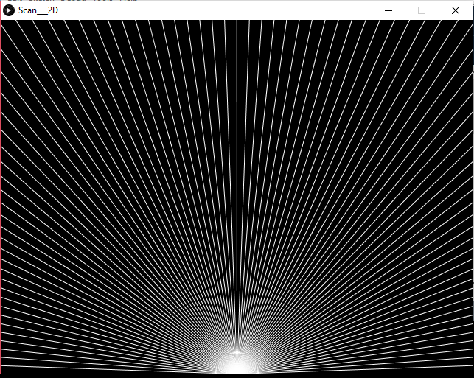
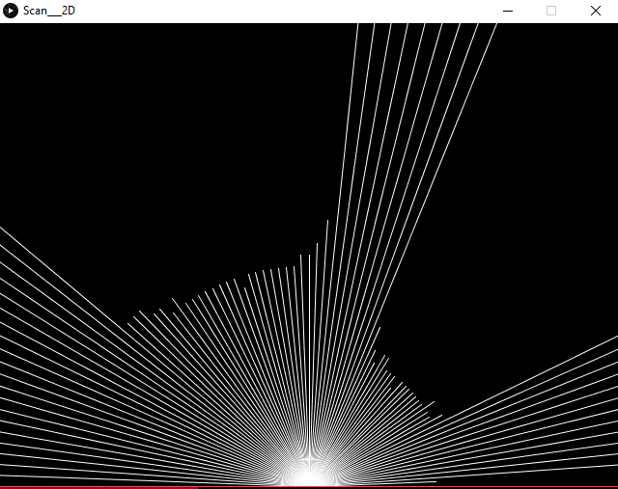
DATA VISUALIZATION
Data of 1D Distance Acquisition Sensor
Data visualisation in MS Excel
Data visualisation in Processing

Slide 25
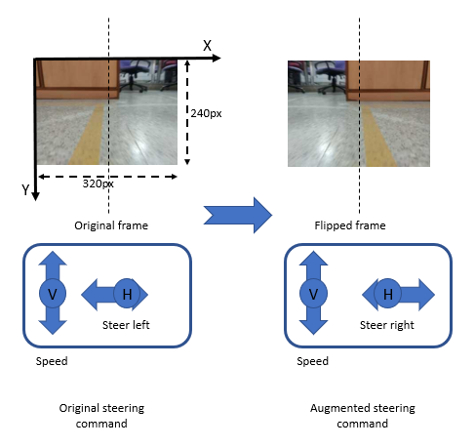
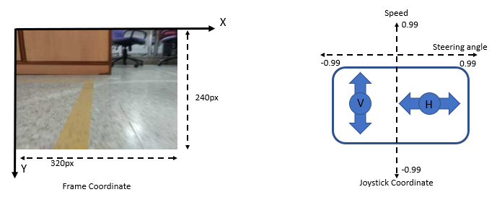
DATA VISUALIZATION
Data Augmentation for Images
Importance of data augmentation:
Technique for increasing training accuracy
Brings variability of data by random transformations, which needs the steering data to be adjusted
Increases the data set
Three performed transformations – flip, crop and translate
Frame and joystick coordinate system
Flipped image and adjust steering angle

Slide 26


DATA VISUALIZATION
Data Augmentation
Cropping is done to reduce unwanted data, so reduces the size of the image.
Translation of image in this case is helpful for adjusting to the track.
Random translation
Crop

Slide 27
METHODOLOGY
Data Description:
1D-Distance Acquisition Sensor
Each pixel value indicates positional data.
The data is dependent on its neighbouring pixels.
1-Dimensional data
Loss of relevant information if data is shuffled.
Robot data acquisition:
Camera images of dimension = 240x320
Frame rate = 10 fps
The pixel values are dependent on neighbouring pixel values.
Loss of relevant information if data is shuffled.

Slide 28






METHODOLOGY
Using convolution for 1D Array of data:
M M M M 7 8 7 7 9 M 4 4 4 6 M 9
10 m
Monitor displaying objects and spaces as sensor interprets – viewed in Processing

Slide 29











METHODOLOGY
Image representation based on number of kernels and layers
Original Image
Convolution operation
No. of filter : 3
No. of layers : 1
Convolution operation
No. of filter : 2
No. of layers : 2
Convolution operation
No. of filter : 1
No. of layers : 1

Slide 30
METHODOLOGY
End-to-End learning:
Sensors
Feature Extraction
Object Recognition
Sensors
Now often combined using Convolutional neural nets
Deep Convolutional Neural Network
Cost Map
Actuation
Planning
Actuation
Usual Approach for self-driving car
End-to-End Approach

Slide 31


METHODOLOGY
Model Description
Direction classification
Actuators value regression
Sensor data
Convolution layers
Pooling layers
Feature Extraction layer
Output layer
Actuator Output

Slide 32

METHODOLOGY
Direction classification
Actuators value regression
Distance Sensor
Correct Predictions
Input data
Desired direction commands
1D-CNN
Output data
Error
Optimized weights
Updated weights
Backpropagation

Slide 33
TRAINING AND RESULT
Direction Classification for object avoidance
Input from sensor
Sensor data to processor
Pooling layer
Convolution layer
A
A
objects
B
B
Sectorised data layer
Backpropagation
Environment perceived by the Car
Hidden network layer
Calculate Error
Input to Bot steering
Output layer

Slide 34

TRAINING AND RESULT
Direction Classification for object avoidance
Summary of the Model

Slide 35


TRAINING AND RESULT
Direction Classification for object avoidance
Training parameters in different network architectures
Test result on a subset of data

Slide 36

TRAINING AND RESULT
Actuator value prediction for path following
Best trained network parameters and architecture

Slide 37


TRAINING AND RESULT
Actuator value prediction for path following
Training parameters in different network architectures
Loss and accuracy graphs, 25% validation loss, and 74% validation accuracy till 20th epoch

Slide 38
CONCLUSION
Compacts the working of different modules in a system into a single neural net.
End-to-end learning works well for comparatively smaller size of data, where data complexity and number of steps for traditional recognition is less.
For image based problems, where number of representational features are more, the network architecture may grow in size.
Used 2 different sensors for data acquisition for different tasks, and applied end-to-end learning for prediction.
Using 2 different datasets for achieving the correct predictions, end-to-end learning shows better accuracy for object avoidance than path following.
Ongoing research and studies prove that, learning systems consisting of less number of modules can show consistency and improve accuracy than training a larger system.

Slide 39
REFERENCES
Dean A. Pomerleau, “ALVINN: An Autonomous Land Vehicle In a Neural Network.” January 1989. CMU-CS-89-107.
Junqing Wei, Jarrod M. Snider, Junsung Kim, John M. Dolan, Raj Rajkumar and Bakhtiar Litkouhi, “Towards a Viable Autonomous Driving Research Platform”, 2013 IEEE Intelligent Vehicles Symposium (IV).
Jesse Levinson, Jake Askelan, et al. “Towards Fully Autonomous Driving: Systems and Algorithms.” 2011 IEEE Intelligent Vehicles Symposium (IV).
Avinash Nehemiah, Arvind Jayaraman. “Deep Learning for Automated Driving with MATLAB.” Accelerated Computing (https://devblogs.nvidia.com/accelerated-computing).
Luca Caltagirone, Mauro Bellone, Lennart Svensson, Mattias Wahde.” LIDAR-based Driving Path Generation Using Fully Convolutional Neural Network.” arXiv: 1703.08987v2, April, 2017.
Matthew Browne, Saeed Shiry Ghidary, “Convolutional neural networks for image processing: an application in robot vision”. The 16th Australian Joint Conference on Artificial Intelligence-AI’03 Dec 2003,Perth,Australia.
C. Chen, A. Seff, A. Kornhauser and J. Xiao, “Deepdriving: Learning affordance for direct perception in autonomous driving”, in Proceedings of the IEEE International Conference on Computer Vision, 2015.
M. Bojarski, D. Tel Testa, D. Dworakowski et al., “End-to-End learning for self- driving cars.” arXiv preprint arXiv:1604.07316, 2016.
Andrej Karpathy, Justin Johnson, Li Fei-Fei .” Visualising and Understanding Recurrent Networks”. arXiv: 1506.02078v2, 17 Nov 2015.
S. Hochreiter, J. Schmidhuber,” Long Short-Term Memory”. Neural Computation 9(8): 1735-1780,1997.
Dan C. Ciresen, Ueli Meier, J. Schmidhuber et al.” Flexible, High Performance Convolutional Neural Network for Image Classification”. Proceedings of the 22nd International Joint Conference on Artificial Intelligence.
Luca Caltagirone, Samuel Scheidegger, L.Svensson, M. Wahde. “Fast-LIDAR-based Road Detection Using Fully Convolutional Neural Networks”.arXiv:/1703.03613 29th March,2017.
Wende Zhang. “Lidar based Road and Road-Edge Detection”, IEEE.Tobias Glasmachers Institute for Neural Computation, Ruhr-University Bochum, Germany. arXiv:1704.08305v1 [cs.LG] , 26 April 2017.

